Slide 1

EXCELR
HOSPITALITY ANALYSIS
PROJECT
Sangitha Bhosale
Aadil Farhan
Deventi
Haritha
Geeta Dasari
Yaswanth
Chandrashekar
GROUP - 4

Slide 2


Slide 3

Hospitality
Analysis
Introduction
KPI’s
Dashboard
Conclusion
Insights from the data
Data Cleaning & Process

Slide 4
🌟 Introduction
Focused on analyzing key metrics for the hospitality industry to improve decision-making and guest experiences.
Leveraged Excel for data cleaning, preliminary analysis, and creating pivot tables.
Used SQL to extract, clean, and prepare data from multiple hotel databases.
Built interactive dashboards using Power BI to analyze revenue, occupancy, bookings, and guest segments.
Created advanced visual analytics using Tableau to identify trends, seasonal patterns, and performance differences across hotels.
Analyzed data by hotel, customer category, and time periods to uncover actionable insights.

Slide 5
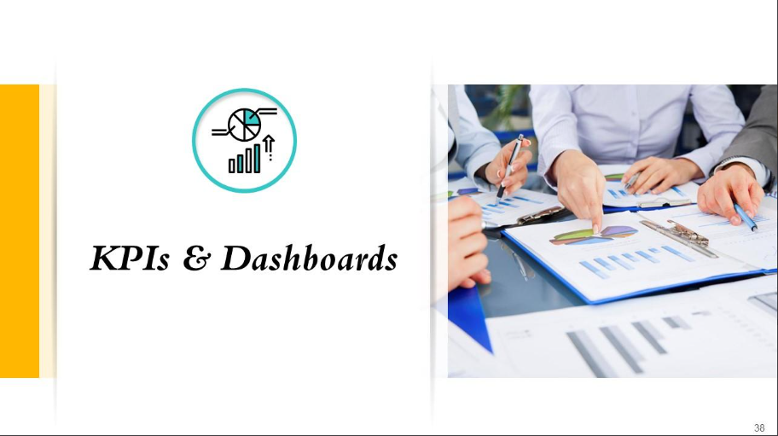

Slide 6

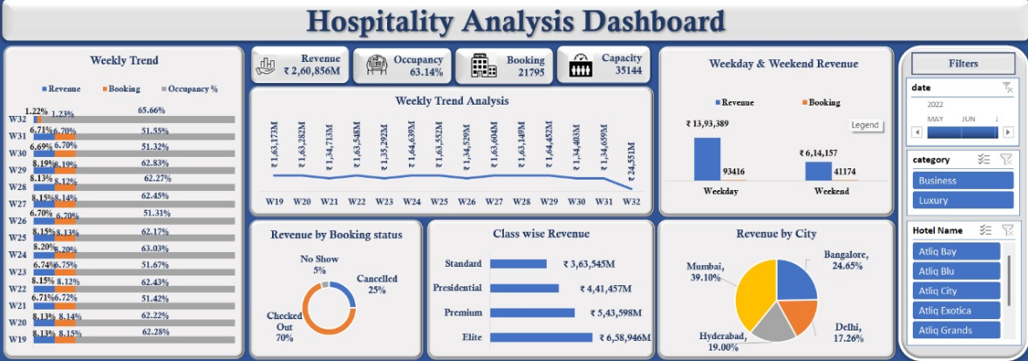
EXCEL DASHBOARD

Slide 7
Insights from the data
📊 Weekly Trend — Explanation Shows week-wise comparison
✅ Revenue and bookings remain stable at 100% across all weeks, indicating consistent business flow.
✅ Occupancy rate is also steady around 58.31%, showing good utilization of available rooms.

Slide 8
Weekly Trend Analysis chart :The chart shows a trend line across weeks 19 to 32, which allows us to analyze performance or activity over time.
The X-axis represents the weeks (W19 to W32), showing a continuous timeline.
The Y-axis likely represents a numeric metric like sales, occupancy, revenue, bookings, or similar performance indicator Each point on the line corresponds to data for that particular week, helping identify increases, decreases, or stable trends.

Slide 9
Weekday & Weekend: Revenue & Booking The chart compares Revenue and Booking numbers between weekdays and weekends.
Both categories (weekday and weekend) show the same revenue value of ₹20,07,546.Similarly, the number of bookings is also the same on both weekdays and weekends: 134590.

Slide 10
The chart is a donut chart breaking down revenue contributions based on the booking status Breakdown:
Checked Out (70%)The largest portion of revenue comes from guests who completed their stay and checked out.
This indicates a strong conversion of bookings into actual stays. Cancelled (25%)A significant part of revenue is affected by cancellations.
This suggests potential lost revenue opportunities, and may point to issues like strict cancellation policies, price sensitivity, or external factors. No Show (5%)A small percentage of revenue is from Although lower, it still represents missed revenue and possible operational inefficiencies.

Slide 11
Class-wise Revenue
This horizontal bar chart shows revenue distribution across different room classes
Standard Revenue: ₹20,07,546M
Presidential Revenue: ₹20,07,546M
Premium Revenue: ₹20,07,546M
Elite Revenue: ₹20,07,546M
All four room classes — Standard, Presidential, Premium, and Elite — show exactly the same revenue amount (₹20,07,546M).

Slide 12
Revenue by City
This is a pie chart that shows the revenue contribution from different cities shown:
Mumbai
Bangalore
Hyderabad
Delhi
Each city is marked as contributing 100.00%, and each slice of the pie chart looks equal.

Slide 13
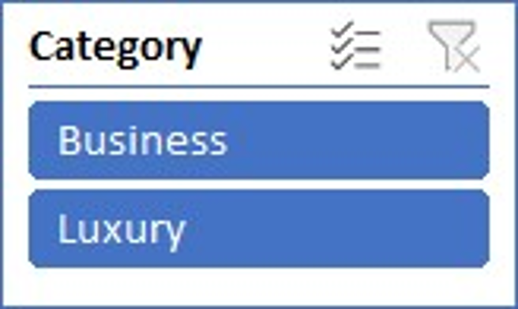
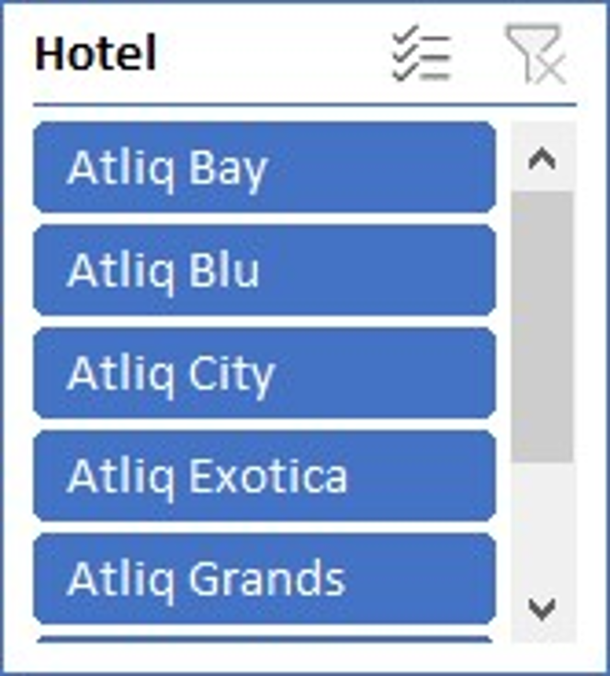
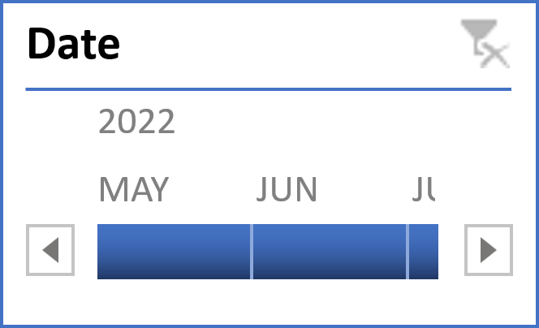
🏷️ Category Filter Options selected: Business, Luxury This means the data will be shown only for bookings or transactions related to these two categories.
📅 Date Filter Year: 2022Months selected: May, June, July This filter allows you to narrow down data for these specific months in 2022.
🏨 Hotel Filter Hotels selected:
Atliq Bay
Atliq Blu
Atliq City
Atliq Exotica
Atliq Grands

Slide 14

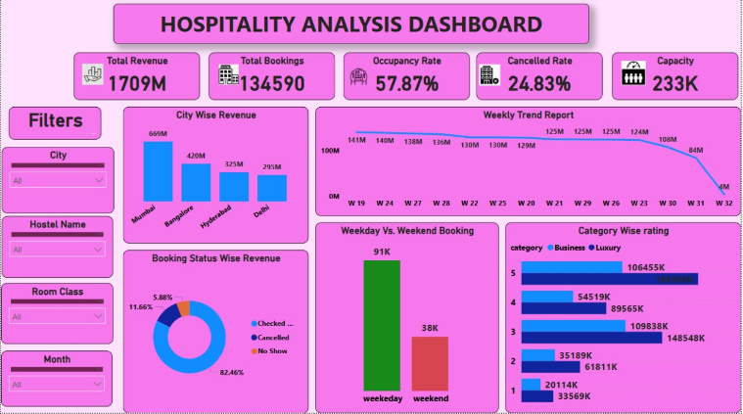
POWER BI - DASHBOARD

Slide 15

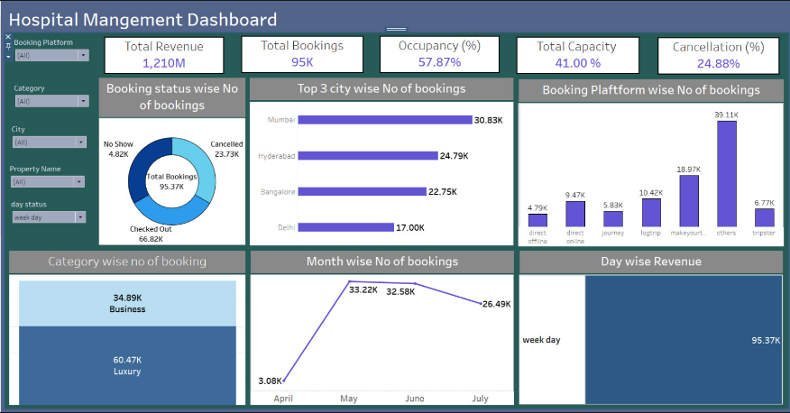
TABLEAU - DASHBOARD

Slide 16

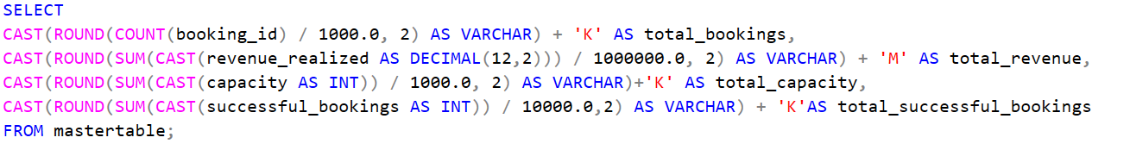

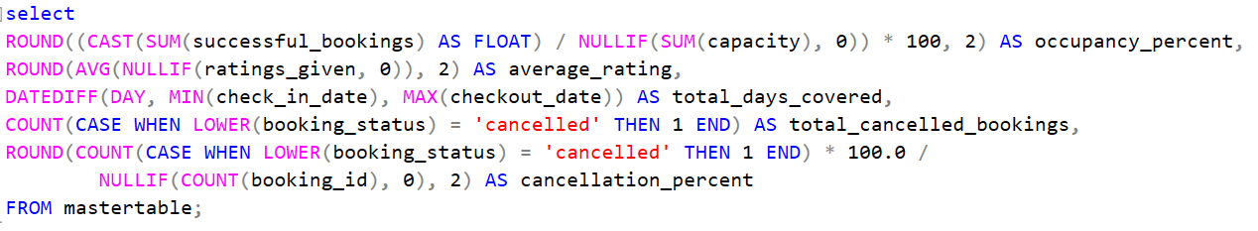
KPI 1. calculate Total_Revenue,Total_Bookings,Total_Capacity, Total Succesful Bookings.
Output
KPI 2. calculate Occupancy%, Average_Rating, No_of_days, Total_cancelled_bookings, Cancellation %
Output

Slide 17
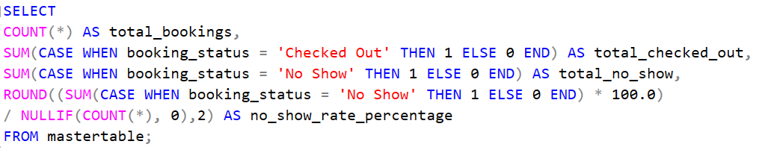
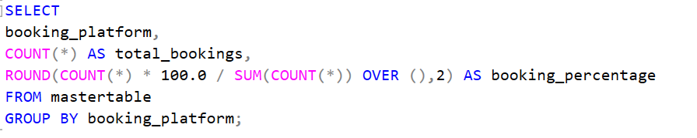
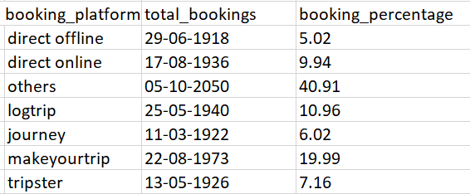

KPI 3. Calculate Total Checked Out, Total_No_show_bookings, No_Show_rate %.
KPI 5.Booking % by Platform
Output
Output
KPI 4. ADR(Avg Daily Rate)
Output

Slide 18
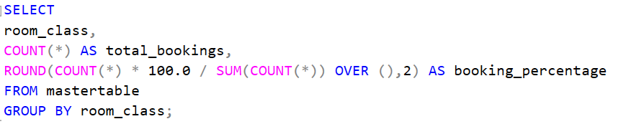
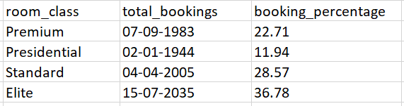
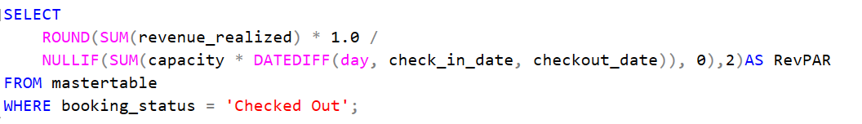
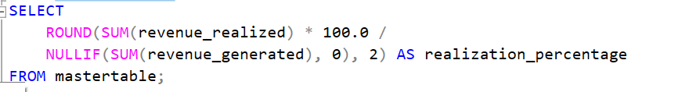


KPI 6.Booking % by Room Class
Output
KPI 7. Realisation %
KPI 8.RevPAR (Revenue per Available Room)
Output
Output

Slide 19

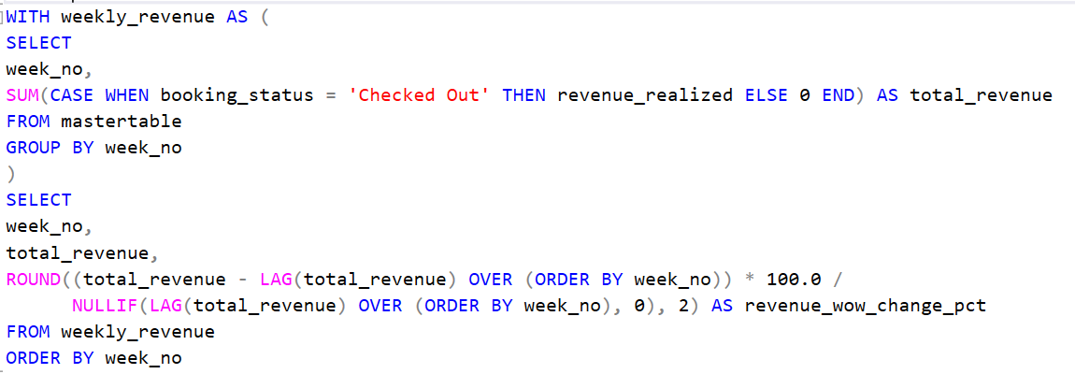

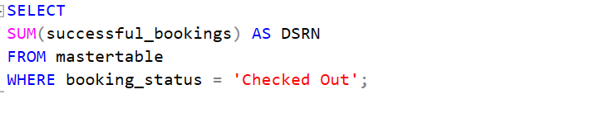
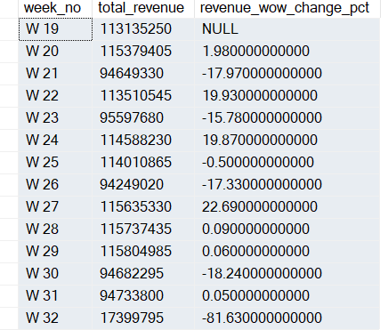

KPI 9. DBRN (Daily Booking Room Nights)
KPI 11. Revenue WoW change%
Output
KPI 10. DSRN (Daily Sold Room Nights)
Output
Output

Slide 20
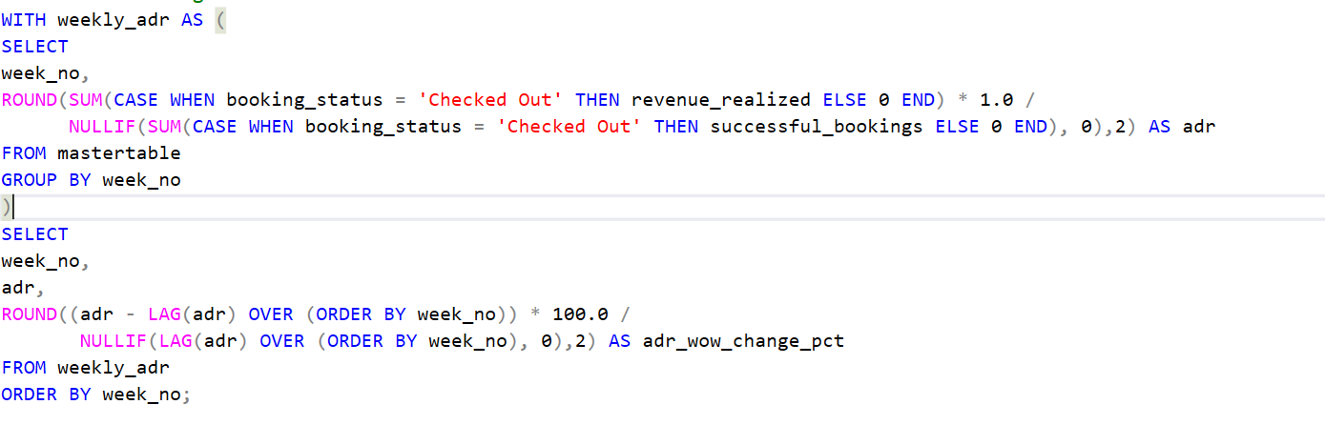
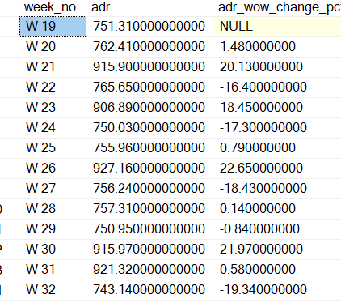
KPI 12. ADR WoW change %
Output

Slide 21
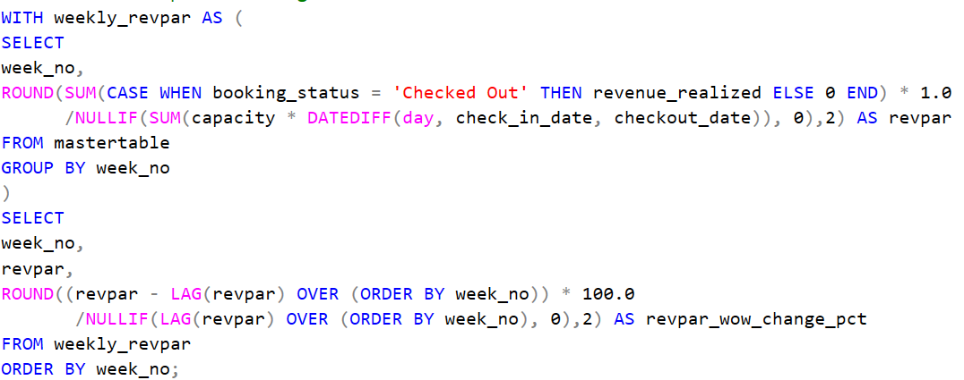
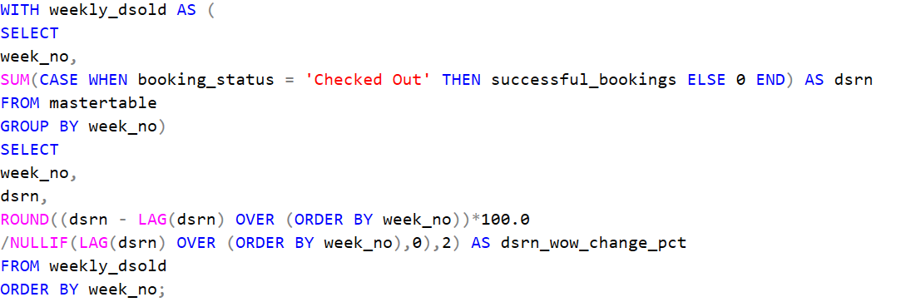
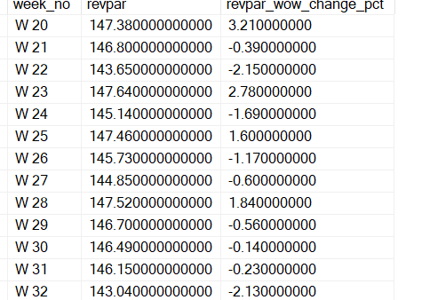
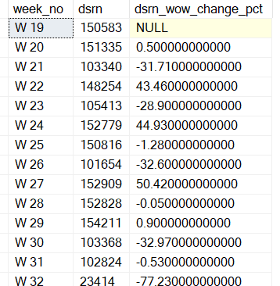
KPI 13. Revpar WoW change %
KPI 14.DSRN WoW change %(Daily Sold Room Nights Week-over-Week % Change)
Output
Output

Slide 22

In this hospitality analysis project, we successfully leveraged advanced data tools — Excel, SQL, Power BI, and Tableau to gain actionable insights into hotel performance and guest behavior.
Overall, this comprehensive approach provided valuable insights, such as : Identification of high-performing hotels and room categories.
Understanding seasonal demand fluctuations.
Recognizing key revenue drivers and growth opportunities.
Enhancing decision-making for targeted marketing and operational efficiency.

Slide 23


